Slide 1

Inventory Management System for Global Retailers Inc
Group – 2
Gowri Rohith chirra (U00904650)
Rohith Reddy Garlapati (U00904490)
MIS-7610-002 System Analysis & Design Fall Term 2023
Professor: Robert Rose

Slide 2

"Inventory Management System for Global Retailers Inc."
"A Comprehensive Approach to Modernizing Operations"

Slide 3
Industry and Organization Background
Industry Overview
Retailing in a dynamic landscape with evolving consumer demands and intense competition.
Global Retailers Inc. operates in various product categories, from electronics to clothing and homeware.
The company embraces both traditional and online retailing to stay aligned with modern trends.

Slide 4
Industry and Organization Background
Organizational Profile of Global Retailers Inc.
Large-scale retailing conglomerate known for offering superior-quality products.
Presence in both physical and digital marketplaces.
Commitment to meeting changing consumer demands through a diverse product range.

Slide 5
Planning Phase
1. Organizational Information
Brief Overview of Global Retailers Inc.
Retailing Conglomerate
Wide Product Range: Electronics, Clothing, Homeware
Presence in Traditional and Online Retail
2. Goals of the IMS Project
Modernize Inventory Control and Management
Address Pressing Issues in Stock Management
Reduce Carrying Costs
Enhance Stock Count Accuracy
Establish Smooth and Effective Inventory Management Across Locations

Slide 6
Planning Phase
3. Alignment with Organizational Strategy
Support Overall Business Plan
Fix Pressing Stock Management Issues
Enhance Operational Efficiency
Improve Customer Satisfaction
4. Value Addition
Standardizing Stock-Taking Methods
Enhancing Stock Count Accuracy
Automating Reorder Processes
Improving Vendor Management
Providing Analytical Reporting for Informed Decision-Making

Slide 7
Goals/Project Identification
"As Is" System Overview
Manual inventory management processes
Lack of real-time visibility into inventory levels
Dependence on traditional methods for stock-taking
Absence of a centralized system for multi-location control

Slide 8
Current System Issues
Inefficiency: Reliance on manual procedures leads to inefficiencies in stock management.
Inaccuracy: Manual stock counts contribute to inaccuracies and errors.
Operational Delays: Non-automated reorder processes result in delays in order processing.
Customer Impact: Lack of real-time information affects customer satisfaction.

Slide 9
Feasibility Study
1. Technical Feasibility
Definition: Evaluating the project's technological aspects and determining if the proposed Inventory Management System (IMS) can be effectively implemented.
2. Economic Feasibility
Definition: Examining the financial viability of the IMS project, considering costs, benefits, and return on investment (ROI).
3. Organizational Feasibility
Definition: Analyzing how Ill the IMS aligns with the organizational structure, culture, and capabilities of Global Retailers Inc.

Slide 10

Project Selection and Management
Phases of the Project:
Breakdown of the project into key phases.
Overview of each phase's purpose.
Deadlines/Milestones:
Timeline for each phase or milestone.
Emphasis on key deliverables and their scheduled completion dates.

Slide 11
Requirements Determination
Requirements Gathering Techniques
Notes:
Documenting key points, observations, and stakeholder comments during interviews and observation sessions.
Questionnaires:
Developing targeted questionnaires to gather specific information from a broader audience.
Interview Transcripts:
Creating detailed transcripts of interview sessions with stakeholders.
Storyboards:
Developing visual storyboards to illustrate how users envision interacting with the Inventory Management System.
Prototyping:
Developing prototype interfaces for the IMS and gathering feedback from potential users.

Slide 12
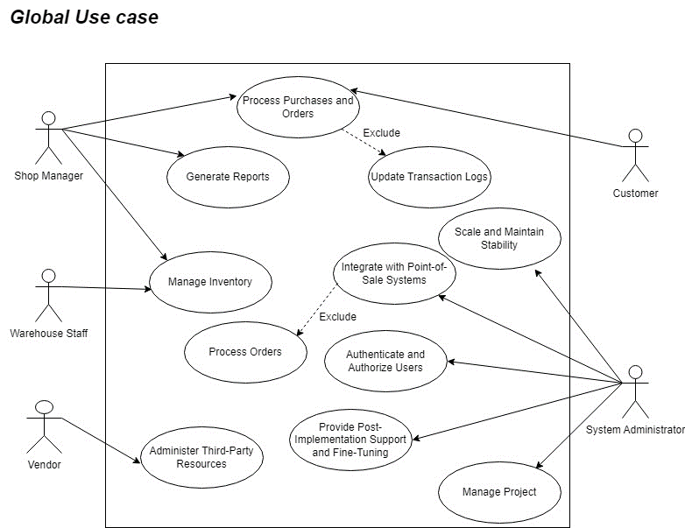
Use Case

Slide 13
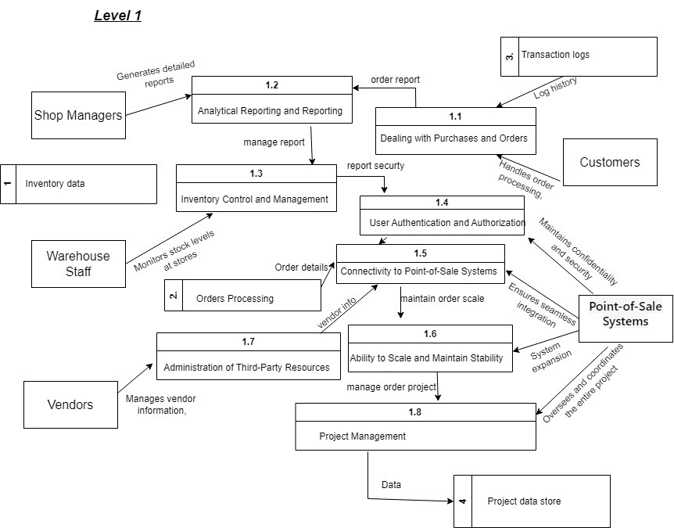
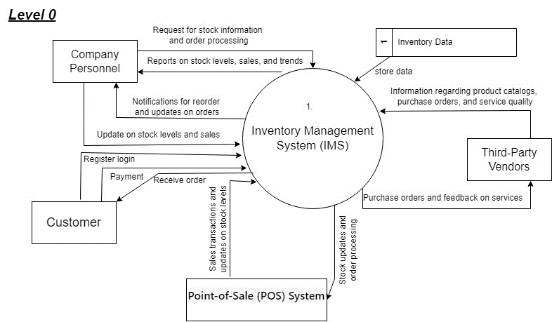
DFD

Slide 14
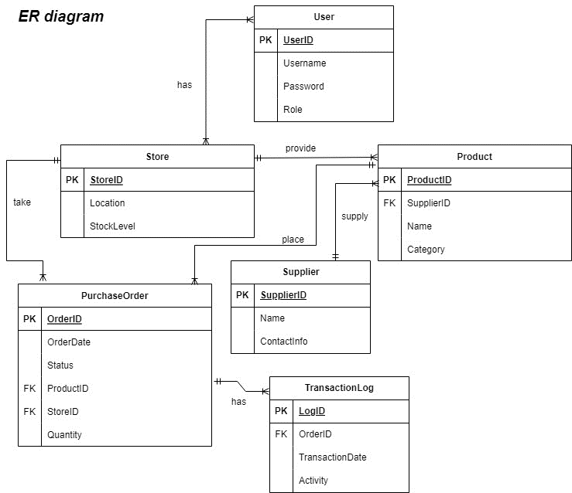
Entity Relationship Diagram

Slide 15
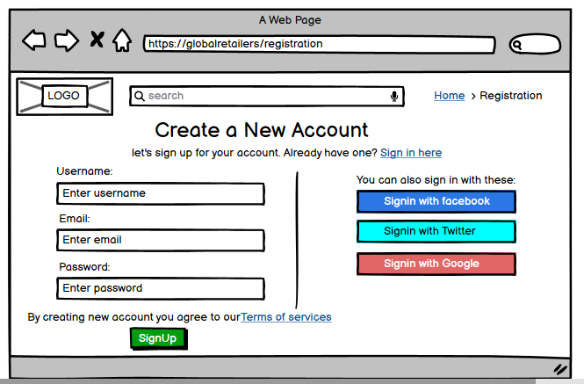
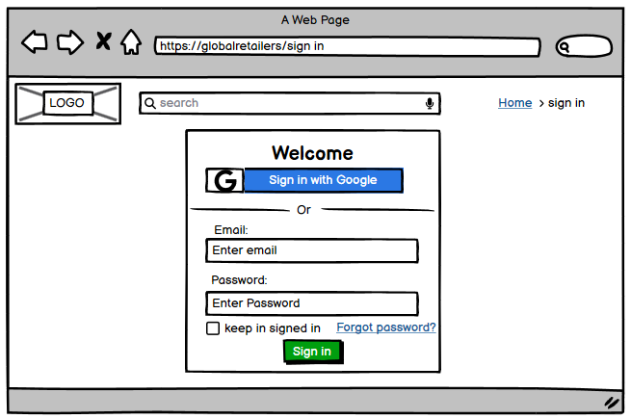
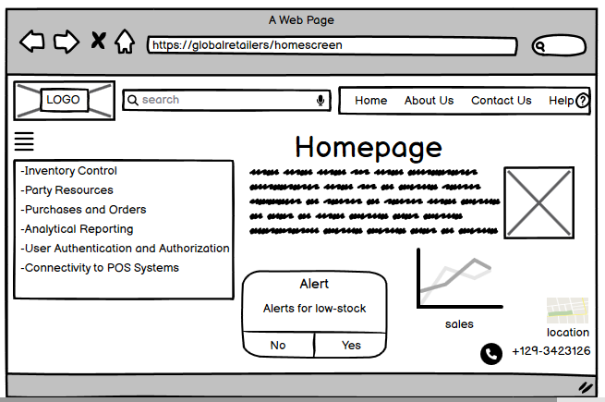
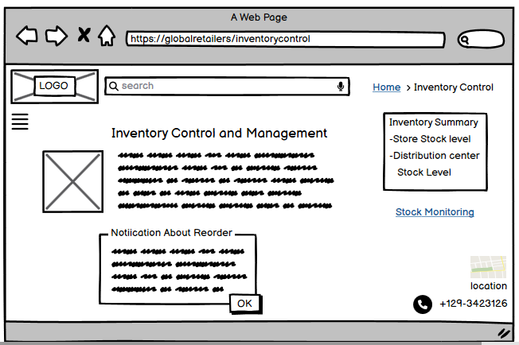
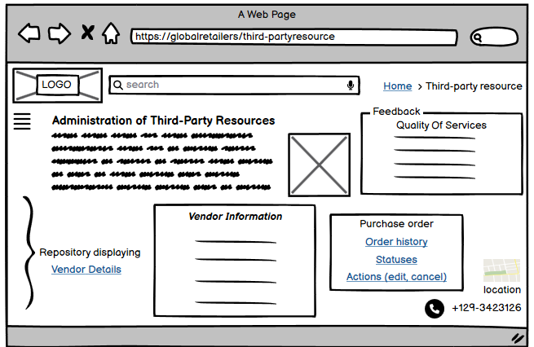
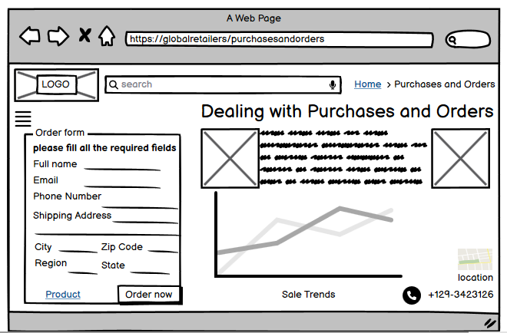
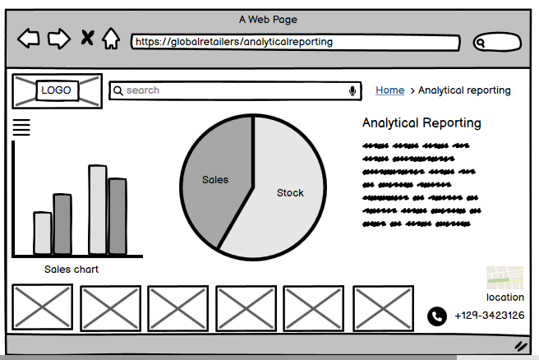
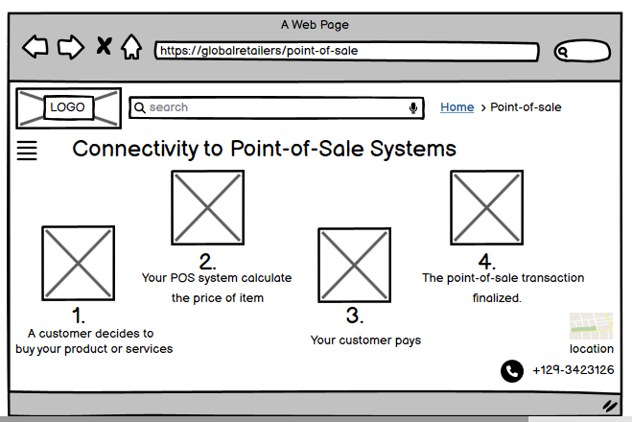
UI Diagram

Slide 16
Implementation Plan
System Development, Testing, Deployment
System Development
In-house development of IMS components: front-end, back-end, and database.
Based on architecture and design specifications.
Emphasis on maintaining alignment with organizational goals.
Testing
Rigorous testing to identify and rectify bugs or issues.
User acceptance testing (UAT) for stakeholder validation.
Ensuring the system meets predefined quality standards.
Deployment
Gradual deployment across select locations.
Minimizing operational disruption during the rollout.
Monitoring system performance and addressing issues promptly.

Slide 17
Implementation Plan
Training, Integration with POS Systems
Training
Comprehensive sessions for shop managers, warehouse staff, and relevant personnel.
Hands-on training for practical understanding and proficiency.
Providing training materials for ongoing reference.
Integration with POS Systems
Ensuring seamless communication betIen IMS and existing POS systems.
Conducting thorough testing for data synchronization.
Implementing error-handling mechanisms for consistency.

Slide 18
Implementation Plan
Communication and Change Management
Communication
Establishing effective communication channels.
Keeping stakeholders informed throughout the implementation.
Regular updates on progress, challenges, and upcoming milestones.
Change Management
Implementing strategies to address resistance.
Highlighting benefits of the new system to users.
Encouraging a positive reception and collaboration during the transition.
Notes:
.

Slide 19
Transition Plan
Migration Plan:
Gradual migration from the old system to the new IMS to minimize disruptions.
Detailed planning of data transfer and system switchover.
Contingency and rollback plans in case of unforeseen issues.
Training:
Comprehensive training sessions for all users, including shop managers, warehouse staff, and other relevant personnel.
Hands-on training to ensure practical understanding and proficiency with the new system.
Training materials and resources provided for ongoing reference.

Slide 20
Transition Plan
Motivating Employees:
Recognition and celebration of milestones during the implementation to boost morale.
Communicating the benefits of the new system, emphasizing how it will improve daily tasks and overall efficiency.
Encouraging a positive attitude towards change through motivational activities.
User Support:
Establishment of a dedicated support system to address user queries and issues promptly.
Ongoing support during the initial Ieks to facilitate a smooth transition.
Clear communication channels for users to seek assistance.

Slide 21

Transition Plan
Feedback Mechanism:
Implementation of a feedback mechanism to gather input from users during the early stages of implementation.
Regular collection of feedback to address concerns and make necessary adjustments.
Utilization of feedback for continuous improvement.

Slide 22
Forecast for Maintenance
Growth/Flexibility
Designing for Scalability: IMS built to accommodate future business growth
Adapting to Evolving Needs: Regular updates and enhancements to meet changing requirements
Ensuring System Flexibility: Agile approach to adjust to emerging trends and challenges
Budget Allocation
Allocating Ongoing Maintenance Budget: Provision for regular maintenance, updates, and improvements
Periodic Budget Reviews: Ensuring alignment with project goals and organizational priorities
Cost-Effective Solutions: Optimizing expenses while maintaining system effectiveness

Slide 23
Forecast for Maintenance
Addressing Future Issues/Problems
Proactive Issue Identification: Establishing a proactive approach to identify potential issues
Regular System Audits: Periodic reviews to identify areas for improvement
Swift Problem Resolution: Timely addressing of emerging challenges to ensure system reliability

Slide 24

THANK YOU

